Slide 1
Intro to Javascript
3.1
Variables and Basic Programing Concepts

Slide 2

JavaScript is NOT Java

Slide 3
So what is it?
It is a client side scripting language - it works in your browser rather than on the server
It works with HTML and CSS to create dynamic web pages sites and apps
Created by Brendan Eich as "LiveScript" in 1995, which got renamed to "JavaScript"
Standardized by the ECMAScript specifications. This class covers ES5 (standardized in 2009)

Slide 4
It lets you build dynamic web pages that respond to input from users.

Slide 5
So what can JavaScript do?
For example...

Slide 6
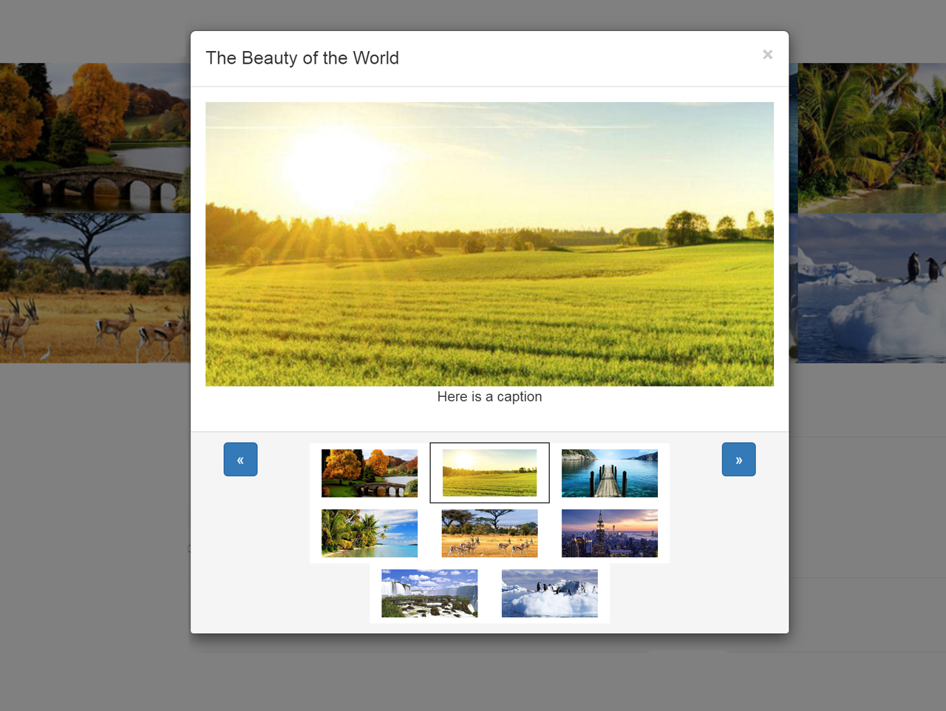
Image Light boxes

Slide 7
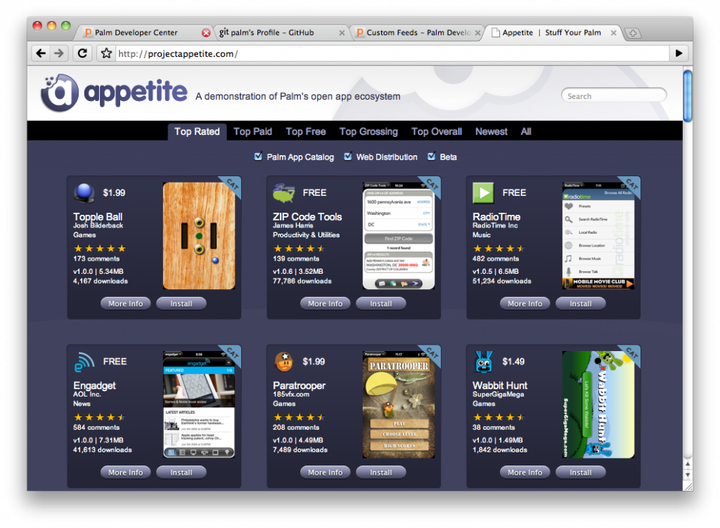
Full on web apps

Slide 8
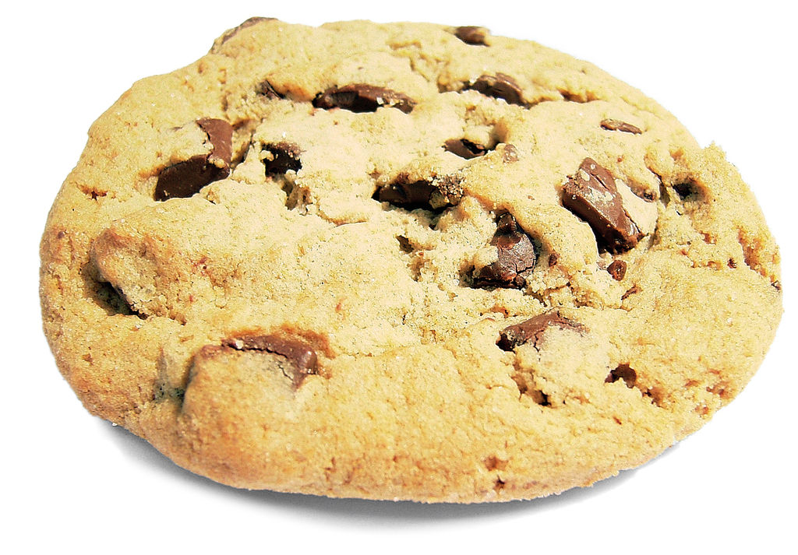
Track users and hold data with cookies

Slide 9
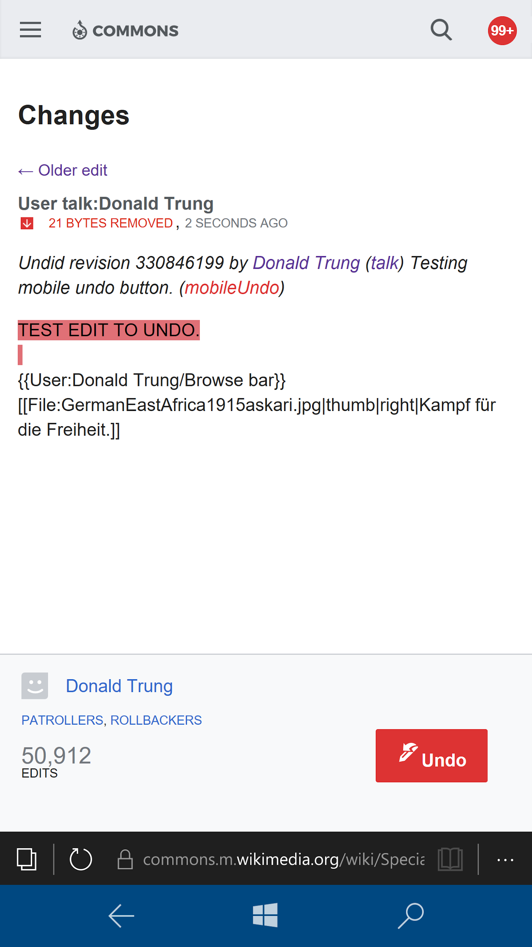
Interactive elements of web pages

Slide 10
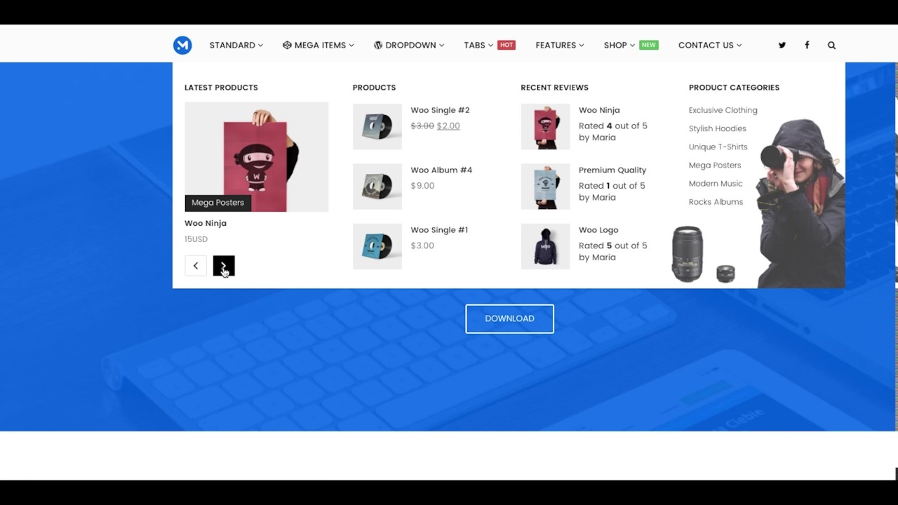
Tabs, Sliders, drop down menus

Slide 11
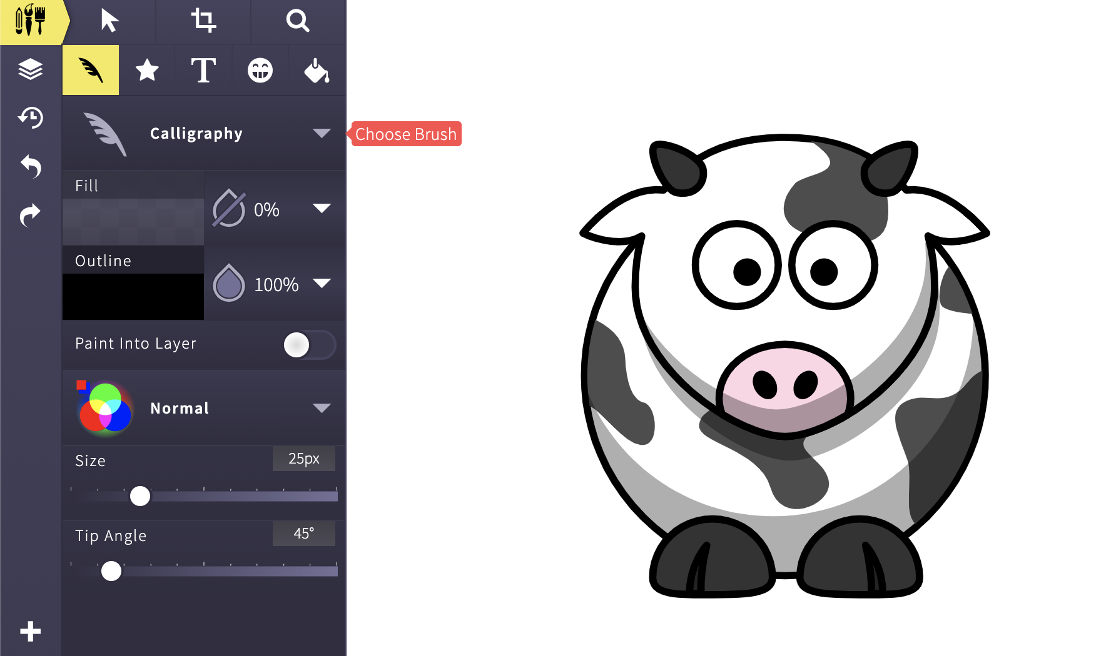
Drawing and Animation

Slide 12
So how do we use it?

Slide 13
You can add it straight into HTML
We use the <script> tag to insert some JavaScript directly into the page. The browser knows that what is in side is code not content.
<script> OUR CODE GOES IN HERE </script>
Just like with css, once the code gets a bit long we are probably best putting it in its own file:
<script src="js/file.js"></script>

Slide 14
Task 3.1.1
Create HTML Document
Setup the HTML Document
In between the body tags write <h1>My First JavaScript Program</h1>
Create a scripts folder to put your JavaScript
Create a file in the scripts folder called task-3.1.1.js
Connect task-3.1.1.html to the javascript file
Add the code to the left to the JavaScript file
alert('Hello World!');
console.log('Secret message');

Slide 15
So what’s happening?
JavaScript tells the browser to pop up that alert box with the message inside.
But where’s the secret message?
Hint: Look for the console

Slide 16
Here’s the thing about computers
They are GREAT at processing but rubbish at understanding
They need instructions to be really simple, and really clear
So
You need to think like a programmer

Slide 17
Break everything down step-by-step to tiny simple pieces

Slide 18
Example
Human instruction
Draw a square on the whiteboard
Computer instruction
Find a dry-wipe marker
Approach the whiteboard
Uncap the dry-wipe marker
Hold the marker in your hand.
Place the marker against the whiteboard.
Move your hand 30cm to the right.
Stop.
Move your hand 30cm down...

Slide 19
This can be irritating and difficult at first

Slide 20
So, how does JavaScript work?
You visit a website with JavaScript code on it.
Your browser (e.g. Chrome) reads the code line-by-line.
The browser runs each line of code as it reads it.
Based on these instructions, the browser performs calculations and changes the HTML and CSS on the page.
If the browser finds code it doesn't understand, it stops running and creates an error message.

Slide 21
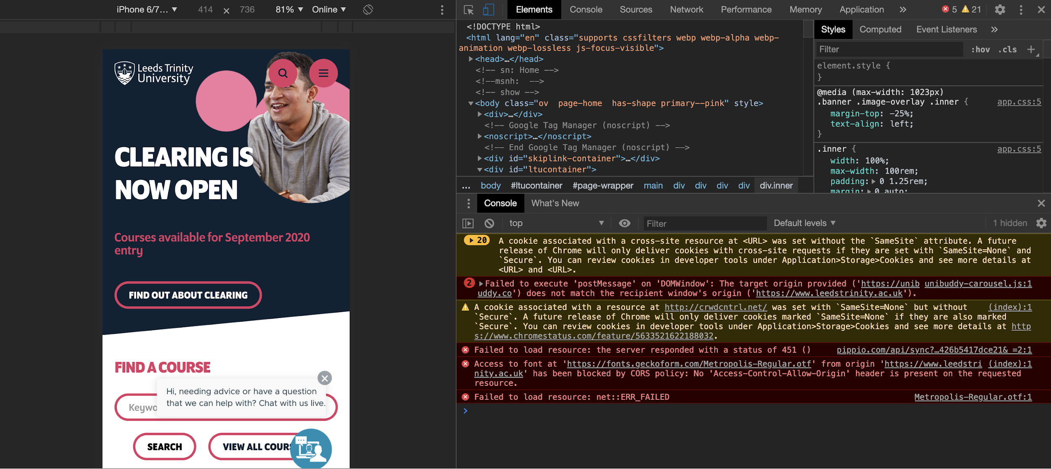
The Console
https://developers.google.com/web/tools/chrome-devtools/console/

Slide 22
Statements
Each instruction in JavaScript is a ‘statement’
console.log('Hello World!'); console.log('I am learning JS'); console.log('I am having SO MUCH fun');

Slide 23
Comments
Just like with HTML and CSS you can leave comments in your code. People can read them but computers will ignore them
/* Slash star like in CSS Is used for hiding multiple lines here */ console.log('Hello World!'); // Or make short one line comments with slash slash

Slide 24
Seeing the results
Open a popup box.
alert('Hello World!');
Display a message in your console.
console.log('Hello World!');
Add something to the page.
document.write('Hello World!');

Slide 25
Task 3.1.2
Add both types of comment to your JS
Print messages using
alert
console.log
document.write
Back to codepen and experiment with what we have just learned

Slide 26
Variables

Slide 27
What’s a variable then?
A variable is a named container to hold a value that might change
A box for storing something that you might use later.
The box has a name e.g. ‘teddy box’
And always contains teddy bears
But the number of teddies inside can change
As you add or remove teddies
You can also think of it like the way you use ‘x’ in algebra

Slide 28
Declaring a variable
To declare (create) a variable, just type the word var and the variable name.
var numberOfKittens;
It is a good idea to give your variable a starting value. This is called initializing the variable.
var numberOfKittens = 5;

Slide 29
Variable Values
When you first create a variable, it does not have a value
(it is undefined).
You can set a value for a variable.
Variables can hold different types of data.
The value of a variable can change over time.

Slide 30
Naming Variables
The variable name is Case-Sensitive
A new variable should have a unique name
Variable names need to start with a letter, dollar sign $, or underscore _
Avoid reserved words
Choose clarity and meaning for humans to read later

Slide 31
Using a Variable
Once you have created a variable, you can use it in your code. Just type the name of the variable.
var numberOfKittens = 5; console.log(numberOfKittens);

Slide 32
Task 3.1.3
Create a variable
Give it a valid name and value
Display the value using
alert
console.log
document.write
Back in codepen

Slide 33
Data Types
string string of characters
var userName = 'Jack Pott';
number integer or floating point
var myAge = 21;
boolean true or false
var catsAreBest = true;
undefined value (hasn't been defined)
var favoriteThings;
null an explicitly empty value
var goodPickupLines = null;

Slide 34
Numbers in Variables
Variables can be numbers, either integers or floats (decimals).
var numberOfKittens = 5; var cutenessRating = 9.6;
JavaScript automatically converts integers to floats
NaN = Not-A-Number

Slide 35
Arithmetic Operators
Once we have numbers in variables we can do some sums with them...
var numberOfKittens = 5; var numberOfPuppies = 4; var numberOfAnimals = numberOfKittens + numberOfPuppies;

Slide 36
Arithmetic Operators
Example | Name | Result
-a | Negation | Opposite of a
a + b | Addition | Sum of a and b
a - b | Subtraction | Difference of a and b
a * b | Multiplication | Product of a and b
a / b | Division | Quotient of a and b
a % b | Modulus | Remainder of a divided by b

Slide 37
Task 3.1.4
Create two variables
Give them valid names and values
Try out some different arithmetic operators
Display the value using any method
Back in codepen - Let’s have JS do some sums

Slide 38
Strings
Variables can be strings (groups of characters). You put your string in single or double quotes.
var kittensName = 'Fluffy';
If you want to use a quote in your string, you'll need to escape it with a backslash.
console.log('I\'d like to use an apostrophe');

Slide 39
String Operators
You can put strings together with a +, the concatenation operator.
var kittensName = 'Fluffy '; var fullName = kittensName + 'McDougle'; console.log(fullName); // Outputs 'Fluffy McDougle'

Slide 40
String Operators
You can also use += to add things to the end of a string.
var kittensName = 'Admiral '; kittensName += 'Snuggles'; console.log(kittensName); // Outputs 'Admiral Snuggles'

Slide 41
Concatenate

Slide 42
Task 3.1.5
Create two variables a first name and a last name
Put them together to output a full name
Don’t forget to display the result
Let’s concatenate some stuff

Slide 43
Combining Strings and Numbers
You can use concatenation to mix strings and numbers. When you do this, JavaScript will treat the number like a string.
var numberOfFruit = 6; var typeOfFruit = 'bananas'; var allTheFruit = 'I have ' + numberOfFruit + ' ' + typeOfFruit + '!'; console.log(allTheFruit);

Slide 44
Take away
Task 3.1.6
Create variables for the pre-tip total and the tip percentage
Calculate the new total
Output a sentence to the page - something like:
Your total bill, with tip, is £35.45
BONUS POINTS:
Use toFixed() to round the output to 2 decimal places
Display the tip amount in the output as well
We’ll make a program to calculate a tip

Slide 45
You just wrote a program in JS

